Slide 1



Digital Portfolio
STUDENT NAME: B.JAISHREE
REGISTER NO: 212402482 & 2A887227A8553ED86A34FB3B36A34EC8
DEPARTMENT: BCA
COLLEGE: AM JAIN COLLEGE
1

Slide 2

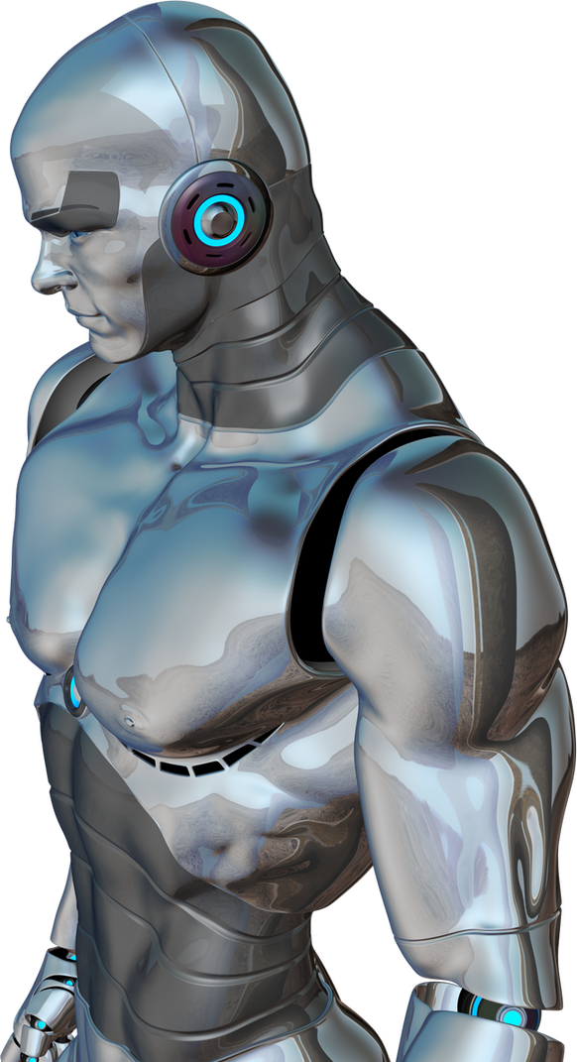
Digital Potfolio
2

Slide 3




AGENDA
1.Problem Statement 2.Project Overview 3.End Users 4.Tools and Technologies 5.Portfolio design and Layout 6.Features and Functionality 7.Results and Screenshots 8. Conclusion 9.Github Link
3/21/2024 Annual Review
3

Slide 4


PROBLEM
STATEMENT
Traditional resumes are static and fail to showcase a developer’s practical skills. There is a need for an interactive, responsive portfolio website that highlights technical expertise, projects, and contact details in a professional way.
4

Slide 5

PROJECT OVERVIEW
This project is a personal portfolio website for Jaishree, a web developer. It showcases skills in HTML, CSS, and JavaScript, highlights a sample project (an E-Commerce Website), and provides contact details. The site is responsive, user-friendly, and designed with a modern, minimal UI for better user engagement.
5

Slide 6
WHO ARE THE END USERS?
Recruiters and hiring managers Potential clients looking for web development services Tech collaborators and peers General visitors interested in the developer’s work
6

Slide 7


TOOLS AND TECHNIQUES
HTML5 – for structure and semantic content CSS3 – for styling, responsive design, and animations JavaScript (ES6+) – for interactivity, navigation, and form validation Font Awesome – for icons Responsive Web Design – for mobile and desktop compatibility
7

Slide 8

POTFOLIO DESIGN AND LAYOUT
Header & Navigation – sticky header with navigation links and hamburger menu Hero Section – developer introduction with call-to- action button Skills Section – cards showing HTML, CSS, and JavaScript expertise Project Section – featured project (E-Commerce Website) with description and tech stack Contact Section – contact info and a functional contact form Footer – social media links and copyright Extras – back-to-top button and smooth scrolling
8

Slide 9
FEATURES AND FUNCTIONALITY
Responsive and mobile-friendly design Smooth scrolling navigation Hamburger menu for smaller devices Interactive project showcase with technology tags Contact form with validation and alert messages Back-to-top button for quick navigation

Slide 10
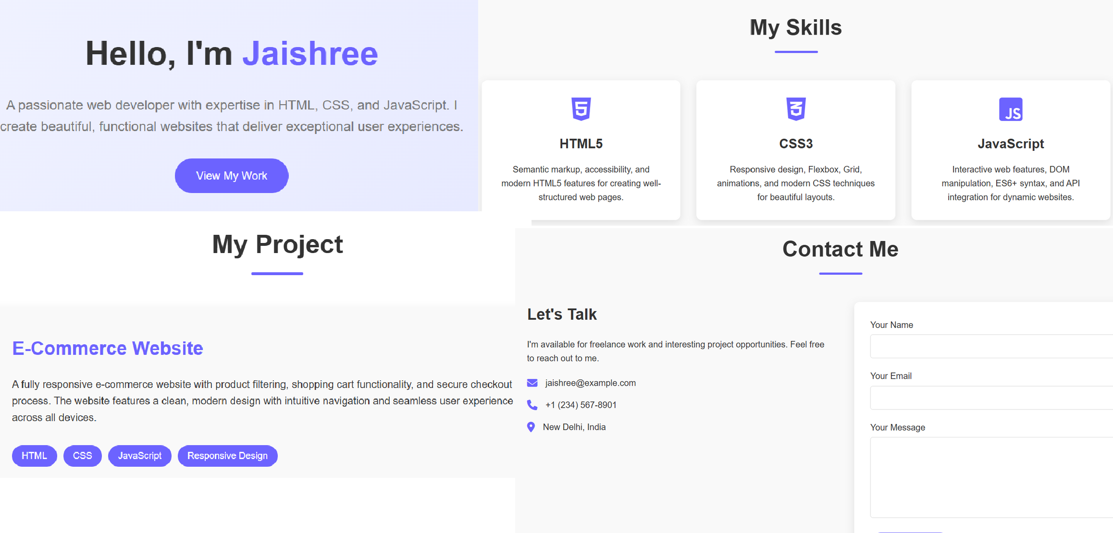
RESULTS AND SCREENSHOTS
3/21/2024 Annual Review
10

Slide 11
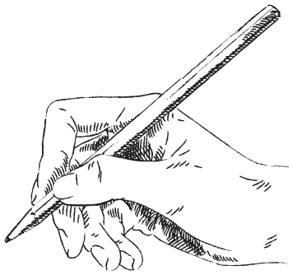
CONCLUSION
The portfolio website effectively serves as a digital resume for Jaishree, combining professional presentation with technical demonstration. It highlights essential web development skills, showcases a sample project, and enables easy communication with potential recruiters or clients.
11

Slide 12
SERVER LIST
https://github.com/24h244-eng/TNSDC-FWD-DigitalPortfolio.git
DEPLOYMENT LINK
https://24h244-eng.github.io/TNSDC-FWD-DigitalPortfolio/

